Slide 1
VMware 产品家族概述
2011.5.9 第一版
2012.12.31 第二版

Slide 2

VMware 的战略是实现“IT 即服务”式交付
用于混合云计算的新 IT 堆栈：安全、可管理、开放
安全私有云
通过 VMware 实现的公共云
独立公共云
VMware 终端用户计算
View
ThinApp
Zimbra
SaaS 应用程序
其他 SaaS 提供商
VMware 云计算应用平台
VMforce
Google App Engine
Spring
vFabric
服务
Hyperic
其他 PaaS 合作伙伴
其他云计算基础 架构提供商
VMware 云计算基础架构和管理
vCloud Datacenter
vCenter
vShield
vCloud Director
vCloud Express
VMware vSphere：云计算的基础
Notes:
VMware’s approach to this challenge is to address each of these unique areas of the CIO’s world while understanding that each layer is intertwined and part of a holistic model for IT
Building upon our existing product lines, but adding new solutions, VMware is uniquely addressing the complete world of the CIO from the changing infrastructure in today’s world to the ability to build and run new applications that best take advantage of this infrastructure to the new and emerging end-user world enabling more agile and efficient access to applications and data via an increasingly diverse set of devices.
Let’s dive into the specifics of what will be announced at VMworld…

Slide 3
VMware 虚拟化及云计算管理解决方案
IT 业务管理
终端用户计算
VMware View
Zimbra
VMware WorkStation
Application Discovery Manager
Config
Manager
vFabric 家族
Hyperic
云计算应用平台
Sevice
Manager
SpringSource
Cloud Foundry
VMware Operation
CapcityIQ
Site Recovery Manager
Ochestrator
第一部分
云计算 基础架构和管理
vCD (vCloud Director)
vShield 家族
ChargeBack
vSphere虚拟化基础平台
vCenter
Notes:
Key Points
VMware is the trusted advisor and cloud infrastructure authority
Using this framework we map to specific solution areas that VMware is focused on (walk through the layers and functional areas) and that are important in virtualized and cloud environments.
At first glance some of these areas will be new (vApp Packaging) while others (provisioning, service desk) may seem similar to a traditional view of management, but as you double click in these spaces you will find that we are focused on functionality that is both critical to and takes advantage of managing in a virtualized or cloud environment. In some areas (compliance & security, performance, service desk) we will dramatically redefine how management is done.
VMware Infrastructure and Operations Management solutions enable IT to create a zero-touch, compliant infrastructure. Native management is designed-in to the virtualized and public, private, and hybrid cloud infrastructure to help deliver self-service through policy-driven control.
VMware Application Management solutions enable IT to quickly, accurately, and confidently transition applications to virtualization and the cloud, mapping dependencies, assuring application portability & performance, and establishing service contracts with the infrastructure.
VMware End-User Computing Management allows IT teams to provision & deploy desktops rapidly, manage workstation images simply, and deliver virtualized applications to desktop.
VMware IT Business Management solutions allow IT and service providers to confidently deliver new levels of self-service while ensuring these new services are automatically governed with appropriate business and process-level controls. Self-service without business governance can lead to sprawl, cost, licensing, chargeback, and security issues.

Slide 4
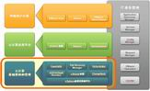
第一部分：云计算基础架构和管理
1、vSphere：作为虚拟化基础软件，大家应该已经有所了解。
2、vCD(vCloud Director): 云计算平台软件。
3、vShield家族：虚拟化安全管理系列软件，主要包含vShield Zone、vShield Edge、vShield App、vShield Endpoint几个方面。
4、ChargeBack：虚拟化资产管理及计费软件。
5、CapcityIQ：容量规划管理软件。
6、Orchestrator：虚拟化自动化部署软件。
7、Site Recovery Manager(SRM)：虚拟化容灾管理软件。

Slide 5
vSphere 5 版本系列
 | vSphere 5 各版本
 | Standard | Enterprise | Enterprise +
授权
虚拟 RAM 授权容量 | 32 GB | 64 GB | 96 GB
虚拟 CPU/虚拟机 | 8 路 | 8 路 | 32 路
功能特性
High Availability
Data Recovery
vMotion
虚拟串行端口集中器
热添加
vShield Zones
Fault Tolerance
用于阵列集成的存储 API，多路径
Storage vMotion
Distributed Resource Scheduler 和 Distributed Power Management
分布式交换机
I/O 控制（网络和存储）
主机配置文件
自动部署
策略驱动的存储
存储 DRS
vSphere 5.0 的新增功能
服务器整合以及无计划内停机
功能强大、高效的资源管理
基于策略的 数据中心自动化
所有版本包括： Thin Provisioning、Update Manager、用于数据保护的存储 API、映像配置文件和 SLES（Ess 和 Ess + 除外）
Notes:
将 ENT+ 的标价提高 500 美元会增加大约 7500 万美元的许可证收入。
5

Slide 6
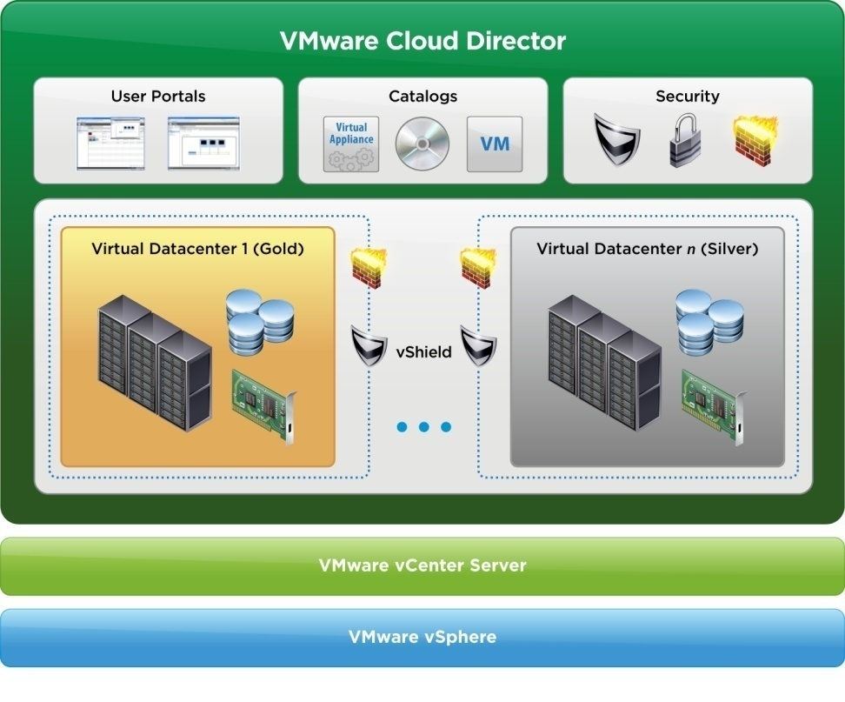
第一部分：云计算基础架构和管理——vCloud Director
定义称为虚拟数据中心的标准基础架构层
跨多个 vCenter Server 创建虚拟化基础架构的资源池
定义称为 vApp 的虚拟机的标准集合
创建组织并使用 RBAC 管理用户
为用户提供 UI，以将 vApp 自行部署到虚拟数据中心
使用 vShield Edge 提供安全的 多租户支持
vCloud Director作为云计算基础平台，需要其它一些功能软件结合使用，才能达到云计算目标。
参见下一张结构图。

Slide 7
第一部分：云计算基础架构和管理—— VMware vCloud 1.5 框架
资产管理
vCloud Service Manager
计费管理
vCenter Chargeback
通用接口
vCloud API
云计算服务平台
vCloud Director
安全管理
vShield Edge
连接器
vCloud
Connector
自动化
Orchestrator
云计算基础架构
VMware vSphere
vStorage API for
Data Protection (VADP)
这些功能组件的灵活组合，可以定制云计算平台。

Slide 8


第一部分：云计算基础架构和管理——vShield家族
虚拟环境下的深度安全防护
Edge
vShield App 1.0 and Zones
vShield Endpoint 1.0
vShield Edge 1.0
Security Zone
Endpoint = VM
对虚拟数据中心进行边界保护
针对应用实现对来自网络威胁的应用防护
实现低负载的防病毒解决方案
Virtual Datacenter 1
Virtual Datacenter 2
DMZ
PCI compliant
HIPAA compliant
VMware
vShield
Web
Test & Dev
VMware
vShield
VMware vShield Manager
VMware vSphere + vCenter

Slide 9



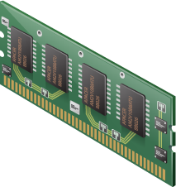

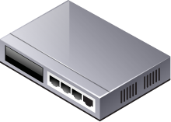

第一部分：云计算基础架构和管理——ChargeBack
虚拟化环境中的资源计费工具
记录、监视、报告虚拟架构中的资源分配及使用情况。
益处
改善资源利用情况:
使cost与VM建立计费关系，提升SLA
预算优化:
业务部门能够知晓他们使用的资源总量以及尚未使用的部分，为他们提供了优化资源、节省成本的依据。
主要特点
固定的、已分配的、以利用的资源都可以与成本建立联系
能够掌管虚拟架构中不同等级的虚拟机数量
能够提供report或者通过email等方式供管理者使用

Slide 10

第一部分：云计算基础架构和管理——Orchestrator
用于协调虚拟化的工作流引擎
无需编写脚本，只需通过拖放接口 即可实现手动、重复步骤的自动化
为与该环境相关的所有流程实现 工作流管理集中化
轻松管理和控制大型环境
为复杂的环境提供自定义工作流
vCenter Orchestrator

Slide 11



第一部分：云计算基础架构和管理——Site Recovery Manager
Site Recovery Manager 利用 VMware Infrastructure 来转换灾难恢复
站点 A（主）
站点 B（恢复）
vCenter Server
Site Recovery Manager
vCenter Server
Site Recovery Manager
vSphere
vSphere
vSphere Replication
基于存储的复制
简化并自动化灾难恢复工作流：
设置、测试、故障切换和业务恢复
对来自 VirtualCenter 的恢复计划提供集中管理
将手动恢复过程转换为自动恢复计划
简化与第三方存储复制的集成
实现快速、可靠、易于管理且价格合理的灾难恢复
最新版本：SRM 5.0

Slide 12
VMware 虚拟化和云计算管理解决方案
IT 业务管理
终端用户计算
VMware View
Zimbra
VMware WorkStation
Application Discovery Manager
Config
Manager
第二部分
vFabric 家族
Hyperic
云计算应用平台
Sevice
Manager
SpringSource
Cloud Foundry
VMware Operation
CapcityIQ
Site Recovery Manager
Ochestrator
云计算 基础架构和管理
vCD (vCloud Director)
vShield 家族
ChargeBack
vSphere虚拟化基础平台
vCenter
Notes:
Key Points
VMware is the trusted advisor and cloud infrastructure authority
Using this framework we map to specific solution areas that VMware is focused on (walk through the layers and functional areas) and that are important in virtualized and cloud environments.
At first glance some of these areas will be new (vApp Packaging) while others (provisioning, service desk) may seem similar to a traditional view of management, but as you double click in these spaces you will find that we are focused on functionality that is both critical to and takes advantage of managing in a virtualized or cloud environment. In some areas (compliance & security, performance, service desk) we will dramatically redefine how management is done.
VMware Infrastructure and Operations Management solutions enable IT to create a zero-touch, compliant infrastructure. Native management is designed-in to the virtualized and public, private, and hybrid cloud infrastructure to help deliver self-service through policy-driven control.
VMware Application Management solutions enable IT to quickly, accurately, and confidently transition applications to virtualization and the cloud, mapping dependencies, assuring application portability & performance, and establishing service contracts with the infrastructure.
VMware End-User Computing Management allows IT teams to provision & deploy desktops rapidly, manage workstation images simply, and deliver virtualized applications to desktop.
VMware IT Business Management solutions allow IT and service providers to confidently deliver new levels of self-service while ensuring these new services are automatically governed with appropriate business and process-level controls. Self-service without business governance can lead to sprawl, cost, licensing, chargeback, and security issues.

Slide 13
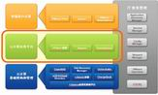
第二部分：云计算应用平台
1、vFabric：
VMware vFabric云应用程序平台结合了市场领先的Spring Java开发框架和诸多平台服务，包括轻型应用服务器、全局数据管理、云就绪的消息传送、动态负载均衡和应用程序性能管理等。基于VMware vFabric开发的应用程序，具有高性能和能够轻松地跨异构云环境进行移植等优点。
VMware vFabric将带来下列主要好处：
· 最大限度地提高速度和创新能力。
· 将虚拟化技术的优势扩展到应用程序。
· 通向云的变革之路。
2、Hyperic：应用程序性能管理。
3、SpringSource：针对Java的企业开发框架，被VMware收购之后，保留原来的开源部分，同时推出商业化的开发平台“vFabric”和开放的PASS平台“Cloud Foundry”。
这部分重点介绍vFabric家族。

Slide 14

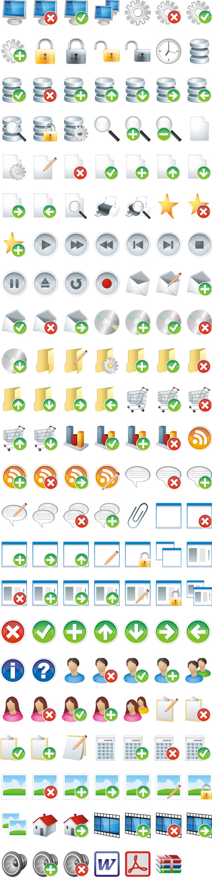










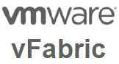
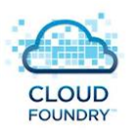
第二部分：VMware 规划的应用程序基础架构
云计算时代的应用程序基础构架
丰富的Web
集成
批处理
数据访问
社交云
云APIs
应用框架
STS
Roo
Groovy&Grails
开发部署工具
PaaS
虚拟数据中心
云计算基础构架和管理

Slide 15
第二部分：云计算应用平台——vFabric云应用开发平台框架
Web服务器
Hyperic HQ
ers
监控&管理
应用服务器
tc server
云消息
数据管理
VMware vFabric
rabbitMQ
gemfire

Slide 16








第二部分：云计算应用平台——vFabric GemFire
Java
Spring 应用
tc Server
Spring 版
Hyperic
通过SpringSource Tool Suite构建
跟踪，监控，报警，管理
轻量级应用容器
GemFire Enterprise
分布式数据网格
会话复制& 数据/对象存储,
跨地域复制 & 数据分区, 消息队列 & 提示, …
文件系统
数据库
其他数据系统
Notes:
- Gemstone was an important acquisition for SpringSource's vision of providing infrastructure for emerging cloud centric applications
- has built-in availability, scalability and performance guarantees
- it even allows scalability for applications deployed across geographically distributed architectures
- new approach to data management (getting away from traditional relational databases)
- low latency, partitioning and colocation
- can move functionality to the data for peak performance.

Slide 17



第二部分：云计算应用平台——vFabric GemFire的评价
“
现代应用程序最大的软肋就是数据处理. 数据缓存是解决之道…
GemFire 是我们正确的选择.
-Adrian Kunzle, MD
Head of Engineering & Architecture, JPMorgan Chase
”
数据
Notes:
Data management technologies are fundamental to the creation of applications, and with the rise of virtualization and cloud computing, the manner in which applications need to access data is evolving.
New approaches to data management that support the needs of applications deployed across elastic, highly scalable, geographically distributed architectures are needed.
We are acquiring and integrating into the SpringSource portfolio a well-regarded high-performing data management solution with GemStone GemFire.
Cloud computing is a distributed deployment model, and for that reason, caching and data accessibility are of far greater strategic importance than before.
This GemStone acquisition, combined with our recent news around RabbitMQ (cloud messaging system) and Redis (cloud NoSQL database), highlights the critical role data management plays within our strategy.

Slide 18




第二部分：云计算应用平台——vFabric RabbitMQ
Java Spring应用
tc Server
Spring版
Hyperic &
Spring Insight
利用SpringSource Tool Suite构建
跟踪，监控，报警，管理
轻量级应用容器
云应用的消息总线
RabbitMQ
基于AMQP的顶级的消息中间件，提供健壮，可靠的跨系统消息传递
AMQP, SMTP, XMPP, Stomp, …多协议支持
多种访问方式
其他云平台 终端设备 应用程序
Notes:
- RabbitMQ is a complete and highly reliable enterprise messaging system based on the emerging AMQP standard.
- Large vendor adoption of AMQP - Microsoft, Cisco etc.
- RabbitMQ is based on a proven platform, offering exceptionally high reliability, availability and scalability along with good throughput and latency performance that is predictable and consistent.
- JPMogran use RabbmitMQ to send 1 billion messages per day.
-Clustering provides horizontal scale out
- supports full ACID (atomicity, consistency, isolation, and durability) operations and transactions

Slide 19
第二部分：云计算应用平台——vFabric RabbitMQ的优点
基于AMQP的领先消息中间件
开放协议，避免厂商锁定
多协议，多访问方式支持
Amazon EC2 首选的消息服务
Intel 和 LShift 为英国 UK Financial Services sector做的benchamark
每秒130万条消息
http://www.lshift.net/news/intelrabbit.html
是其他开源消息中间件如 ActiveMQ - RabbitMQ 4倍以上的效率
通过插件机制进行功能扩展
支持绝大多数操作系统和主流开发语言接口
兼容其他消息中间件
提供企业级产品和咨询服务

Slide 20

tc Server 是运行 Spring 应用程序的最佳平台
第二部分：云计算应用平台——vFabric tc Server
Spring
Spring
Spring
Java 应用服务器使用率，数据来源：2008 Evans Data Survey
“
”
“
tc Server 就是面向企业的 Tomcat
采用 Tomcat 反映出 Java 开发人员喜欢使用相对较简单的轻量级技术
”
Notes:
As mentioned previously, Spring powers 50% of the applications running on WebSphere, WebLogic, and Tomcat.
The widespread use of Spring alleviates the need for many of the services in heavyweight J2EE application servers such as IBM WebSphere and Oracle (BEA) WebLogic, however, and Apache Tomcat rose in popularity at the same time as Spring due to some of the same value propositions.
This has led to Tomcat being the most widely used Java application server on the market. Note that the %’s on the chart don’t add up to 100% since most enterprises deploy two or more Java application servers. Tomcat is by far the most widely deployed.
SpringSource provides tc Server, an enterprise version of Tomcat that delivers the efficiency and control enterprises need for widely deploying lightweight platforms. Since SpringSource employs the key open source leaders driving the majority of feature enhancements and bug fixes for Tomcat, we are uniquely positioned to deliver this value to the market.
SpringSource is driving this shift to lightweight platforms because it is the best path to achieving new levels of efficiency and flexibility for our customers.
Deploying a lightweight platform running on virtualized infrastructure provides the ultimate flexibility and agility as our customers plot their course towards cloud computing.
What Benefits can be obtained by embracing a lightweight platform?
- Simpler Installation and Provisioning: 20X Smaller Install Footprint: Less than 50MB vs. multi-Gigabytes
- Simpler Configuration and Deployment: Lower complexity across Dev, QA, Staging, Production
- Efficient Resource Utilization: Less application infrastructure = More flexibility for your applications
- Easier Upgrade and Migration: Less infrastructure = Lower complexity = Faster migration / upgrade
- Developer Productivity: Lightweight platforms support agile development methodologies
Tc Server is enabling the path to cloud for such customers as Fidelity, EMC, Associated Newspapers, etc.

Slide 21



第二部分：云计算应用平台——vFabric tc Server主要亮点
熟悉的 Spring + Tomcat 体验
深入了解 Spring 应用程序的性能
通过 STS 实现灵活的 Spring 开发体验
开发人员效率
可对 Spring 应用程序进行性能和 SLA 管理
应用程序部署和服务器管理
丰富的警报定义、工作流和控制操作
分组可用性与事件控制板
确保单向代理通信的安全
运营控制
轻量级服务器 (10MB)，非常适合虚拟环境
模板驱动的服务器实例创建
与多个 VMware 环境集成的体验
针对所有操作的开放式安全 API
部署灵活性

Slide 22
第二部分：云计算应用平台——vFabric ERS
ERS是市场占有率第一的Apache Web Server的企业版
易于安装和使用：打包的和经过验证的Apache Web Server
单个服务器上多版本支持，1.3, 2.0, 2.2
支持多个操作系统： Linux,Unix,Windows etc.
针对企业级应用场景的性能增强和安全增强：Bug fixes, patches
针对SSL安全连接的特别优化
Supports almost all CAs including VerisSign, Thawte, Entrust, and Equifax
Supports the Rainbow CryptoSwift and nCipher nFast acceleration cards
预先配置的经过优化的模块支持和语言支持
针对Perl，PHP等流行语言模块的预先优化配置
LDAP，FTP，SSL,SNMP等模块的配置简化和增强

Slide 23






第二部分：云计算应用平台——vFabric Data Director
vFabric Data Director
自动化的
自助服务
自助创建
备份恢复
克隆
一键式
高可用性
DBA
开发者
基于策略的
管理和控制
资源管控
安全管理
数据库模板
监控
DBA
IT管理员
VMware vSphere
统一的数据库管理平台： 将包括多种开源或者商业数据库
Notes:
下面我想针对三种典型的用户角色介绍一些典型的Data Director应用场景。

Slide 24


第二部分：vFabric Data Director ——“数据库即服务”的统一云平台
开发人员
自助服务，快速响应
稳定、高性能、高弹性
数据库管理员
满足云应用
自动化重复劳动
快速响应，提高用户满意度
稳定、安全、可靠
强大的云管理平台
创新的数据库技术
IT管理员
进一步降低成本
快速响应业务变化
安全可控，减少影子IT
不可或缺的云组件之一
云 + 数据库 = 解决之道

Slide 25

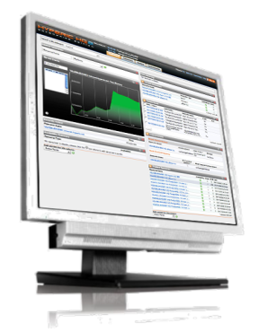




Hyperic 提供自上而下的可见性以达成目标。
第二部分：云计算应用平台——vFabric Hyperic
现代应用程序管理
监控自定义应用程序
管理 Spring 应用程序的最佳工具
自上而下的了解和控制
显示应用程序和服务的详细信息
跨越物理、虚拟和云
管理世界上最大的基础架构
Notes:
In order to ensure applications are aligned with your business goals and are deployed in an agile yet controlled manner, we offer Hyperic.
Hyperic is an application management and monitoring solution used by the person within IT responsible for operating modern applications.
Hyperic provides the top down visibility and control required to ensure the applications are meetings their service levels.
It is fast to deploy and easy to get up, running, and managing your applications.
It is built for Web operations, so it gives the level of detail that the person responsible for operating the application requires to ensure it is meeting business goals.
This top down, deep visibility into applications enables the operator to manage to their required service levels and triggers alerts and control actions if/when service levels are not being met.
Hyperic is built for modern application such as Spring applications and has the ability to manage application infrastructure that spans physical, virtual and cloud environments.
This deep visibility within the applications and services as well as across physical, virtual, and cloud infrastructure enables the application operator to answer such questions as:
Is application performance within SLAs?
What is the source of bottlenecks?
How is the underlying infrastructure impacting application response times?
Can I automate corrective actions?
How can I improve performance?

Slide 26
第二部分：云计算应用平台——vFabric Hyperic适用场景
有多层应用架构的用户，需要了解应用的内部状况
Unix，Linux，Windows, Mac
Oracle, SQL Server, MySQL,Postgresql
Webshere, Weblogic, Jboss, Tomcat, Glassfish etc.
Apache Web server, IIS, .Net
需要同时监控物理环境和虚拟化环境（vSphere）
vFabric组件用户（tc server, RabbitMQ, Gemfire, ERS）
对于监控软件有较高定制化要求的 用户

Slide 27




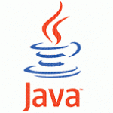









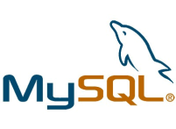



第二部分：业界第一个PASS开源平台 Cloud Foundry
.js
数据服务
vFabric 服务
私有云
消息传递 服务
云计算提供商接口
应用服务
公有云
合作伙伴
其他服务
.COM
微云
Notes:
The third element of openness is in the realm of deployment choices.
The ability to run Cloud Foundry on a range of infrastructures is a fundamental philosophy. CF is supported in the following formats:
Micro cloud foundry: a downloadable developer instance that can run on a developer’s laptop. Limited to a single VM, this provides developers with the ability do run a PaaS on their laptop: they can build and run applications locally without ever having to install middleware! They can build the app locally and then deploy it to their choice of clouds where it can scale up to 100s of instances.
Public clouds: www.cloudfoundry.com is VMware’s offering, but there are many other partners running the service as well so that you are not limited.
Private clouds: we know that customers want to have that PaaS experience inside the firewall, and therefore in FY12 will be providing a private instance of Cloud Foundry that organizations can stand up as a PaaS of their own.
This choice of deployment clouds is one of the elements that really stands VMware apart.

Slide 28
VMware 虚拟化和云计算管理解决方案
IT 业务管理
第三部分
终端用户计算
VMware View
Zimbra
VMware WorkStation
Application Discovery Manager
Config
Manager
vFabric 家族
Hyperic
云计算应用平台
Sevice
Manager
SpringSource
Cloud Foundry
VMware Operation
CapcityIQ
Site Recovery Manager
Ochestrator
云计算 基础架构和管理
vCD (vCloud Director)
vShield 家族
ChargeBack
vSphere虚拟化基础平台
vCenter
Notes:
Key Points
VMware is the trusted advisor and cloud infrastructure authority
Using this framework we map to specific solution areas that VMware is focused on (walk through the layers and functional areas) and that are important in virtualized and cloud environments.
At first glance some of these areas will be new (vApp Packaging) while others (provisioning, service desk) may seem similar to a traditional view of management, but as you double click in these spaces you will find that we are focused on functionality that is both critical to and takes advantage of managing in a virtualized or cloud environment. In some areas (compliance & security, performance, service desk) we will dramatically redefine how management is done.
VMware Infrastructure and Operations Management solutions enable IT to create a zero-touch, compliant infrastructure. Native management is designed-in to the virtualized and public, private, and hybrid cloud infrastructure to help deliver self-service through policy-driven control.
VMware Application Management solutions enable IT to quickly, accurately, and confidently transition applications to virtualization and the cloud, mapping dependencies, assuring application portability & performance, and establishing service contracts with the infrastructure.
VMware End-User Computing Management allows IT teams to provision & deploy desktops rapidly, manage workstation images simply, and deliver virtualized applications to desktop.
VMware IT Business Management solutions allow IT and service providers to confidently deliver new levels of self-service while ensuring these new services are automatically governed with appropriate business and process-level controls. Self-service without business governance can lead to sprawl, cost, licensing, chargeback, and security issues.

Slide 29
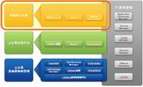
第三部分：终端用户计算
1、VMware View：桌面虚拟化产品（云终端）
大名鼎鼎的桌面虚拟化产品！
VMware最早提出桌面虚拟化技术（VDI），并且现在作为公司除了vSphere之外的另一个重要技术进行推广。
2、Zimbra：邮件管理及协同办公产品。
收购于Yahoo。
Zimbra与众不同的特点是其“Zimlet”网络服务提供了更多的电子邮件功能。核心产品是Zimbra协作套件（Zimbra Collaboration Suite，简称ZCS）。除了它的核心功能是电子邮件和日程安排服务器，当然还包括许多其它的功能，就象是下一代的微软Exchange。在电子邮件和 日程安排之外，它还提供文档存储和编辑、即时消息以及一个利用获奖技术开发的全功能的管理控制台。ZCS同时也提供移动设备的支持，以及与部署于Windows、Linux或apple操作系统中的桌面程序的同步功能。
3、VMware Workstation：
这个产品作为 非企业化虚拟化软件，已经被众多的IT从业者所熟悉，并广泛应用于个人操作系统之上。这里不多介绍。同类的还有VMware Server等。

Slide 30
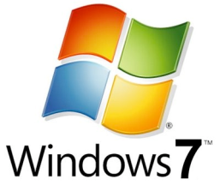




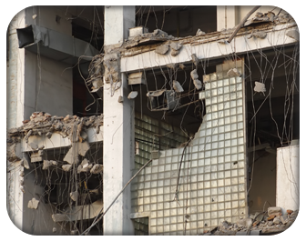
第三部分：终端用户计算——VMware View典型应用场景
Windows 7 迁移
业务流程外包
减少迁移成本
最大程度地减少应用程序不兼容 问题
延长现有桌面软件的使用期限
通过集中管理桌面应用程序和用户降低成本
集中控制敏感数据
简化桌面和应用程序部署
远程办公室/分支机构
移动用户
通过集中管理桌面和用户降低成本
集中控制敏感数据
简化桌面和应用程序部署
无论是否连接网络都可以访问桌面
增强脱机用户的安全性和控制
利用本地设备资源
合同工/EOIT/BYOPC
业务连续性/灾难恢复
部署和管理员工所拥有资产上的 桌面映像
集中控制桌面和数据
分离公司和个人桌面
支持最终用户从远程位置操作
确保桌面全天候可用
快速部署新桌面
Notes:
VMware View helps to address an expanding range of customer use cases including OS migrations, mobile and remote desktop access, contract and offshore employees, as well as Business continuity and Disaster Recovery.
More specific use cases can be found in the appendix of this presentation.

Slide 31
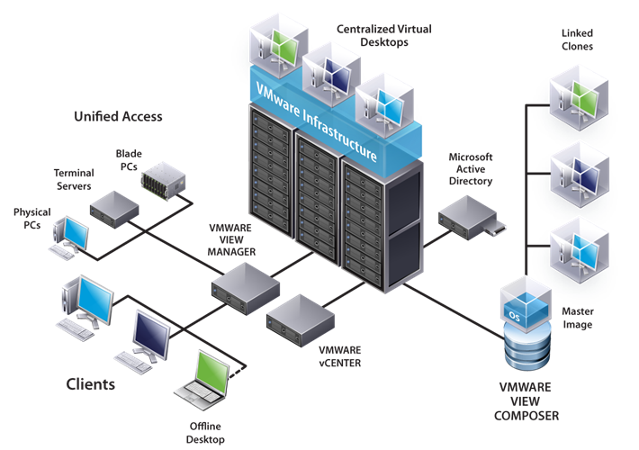
第三部分：终端用户计算——VMware View技术架构
平台
VMware vSphere for Desktops
管理
VMware View Manager
Vmware View Composer
VMware ThinApp
用户体验
最佳显示协议
高级打印
多显示器支持
多媒体
USB 重定向
Notes:
The following high level architecture diagram gives you an overview of the VMware View solution and where all of the components fit
NOTE: we again highlight the 3 key components of the solution - Platform, Management and User Experience
Platform
vSphere for Desktops
VMware View is tightly integrated with vSphere and therefore leverages and benefits from the robust set of features in that platform
vSphere includes many features and optimizations built specifically for delivering VMware View
vCenter (Not Shown) is used to manage the virtualization platform
Management
VMware View Manager
View Manager is the core to the VMware View solution providing centralized management of the desktop environment and brokering of connections to desktops in the data center
VMware View Composer
View Composer delivers storage optimizations to reduce storage requirements and simplify desktop management
VMware ThinApp
ThinApp address the requirement for application virtualization in both virtual and physical desktop environments
User Experience
Users can access their virtual desktops from a variety of devices including desktops, laptops and thin clients
These users can be on the LAN or across the WAN
VMware View has a number technologies addressing user experience which we will talk about in the following slides

Slide 32

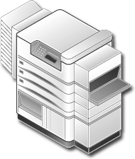


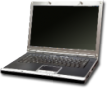

第三部分：终端用户计算——VMware View组件构成
VMware View 5
最佳显示协议
APP
APP
APP
OS
OS
OS
VMware vSphere™
企业级虚拟化平台集成
虚拟打印
View Composer
ThinApp
本地模式
久经考验的
虚拟架构平台
无障碍打印
存储优化
应用虚拟化
灵活机动性
超级用户体验
Notes:
There are 5 key components of the overall VMware View solution that we will discuss now.
VMware Infrastructure which is the Proven Virtualization platform that enables Virtualizing the desktop images.
View Manager (formerly known as Virtual Desktop Manager) which is a enterprise class desktop manager
View Composer which helps optimize storage while streamlining desktop image management
ThinApp – which helps in application virtualization
And finally Offline desktop which helps end users take their virtual desktops offline and work in a disconnected mode.
We will now go through each of these components in further detail.
32

Slide 33

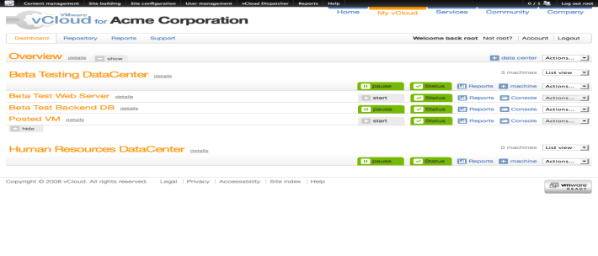
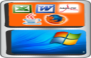

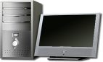



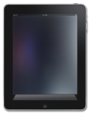

第三部分：终端用户计算——VMware View 的愿景
桌面云计算
云计算桌面基础架构
按需分配资源
可用性
可扩展性
性能
操作系统
应用程序
角色
云计算桌面管理
映像管理
SLA
记帐
部署
维护
策略
安全性
“Redwood”
vCenter – 基于策略进行管理和自动化
View – 通过云进行桌面计算
vSphere – 云计算基础架构平台
桌面应用程序门户
跨设备的个性化访问
手机
桌面
Mac
瘦客户端
脱机
iPad
Notes:
Modernizing the desktop enables the VMware vision
This includes the ability to take advantage of the cloud infrastructure for desktop delivery to enable on demand resources and unmatched availability, scale and performance for the desktop
This also includes simplified image management, provisioning, maintenance and policy enforcement while increasing SLAs and security for the desktop
The modern desktop also allows end-users to access this resource from an increasing variety of devices and locations.
In addition the modern desktop vision enables the ability to implement service based billing and take advantage of user self service functionality in the future.

Slide 34
第三部分：终端用户计算——VMware Zimbra
通常被称为“下一代 Outlook 和 Exchange”，因为它能带来：
跨平台的企业级功能
目前最具创新性的高级 Web 应用程序
开放源代码
最高的部署灵活性
内部私有云、公共云或混合云
与 Exchange 不同，采用了虚拟设备，使用简单，部署简易
与 Google Apps 不同，可以在企业内部进行部署
管理简单，具有最佳的总体拥有成本
开放技术，具有更为高效的 Web 扩展性
专为虚拟化而设计
简化管理
比 Exchange 少 35-50%

Slide 35
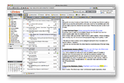
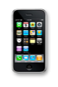
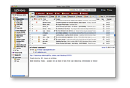
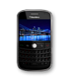
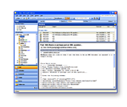
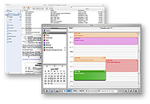
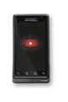
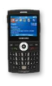
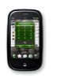
第三部分：终端用户计算——VMware Zimbra产品概述
Zimbra Web 客户端
iPhone
SOAP
ActiveSync、xHTML
Zimbra 服务器
Zimbra 桌面
BlackBerry
SOAP
BES
MAPI
IMAP、CardDAV、CalDAV
Apple 桌面和其他标准客户端
ActiveSync、xHTML
MS Outlook
Android
Win Mobile
Palm
Notes:
35
35
We begin with the server. Any outlook user will tell you that search is hard and slow, and doing the self-archiving is a pain. Zimbra manages everything in the server, making functions like search extremely fast and administration activities like archiving very easy. Another good example is the hierarchical storage, meaning you can have more mailboxes with more data with far fewer servers.
On the top of the slide, we have top of the client with the tabs corresponding to the functions of Zimbra: mail, address book, calendaring, tasks and document management. Also are integration to social and click-to-call.
-Click-
We have two identical clients – one of the web and one for the desktop which enables online/offline access. Anyone who has used OWA (the outlook web application) knows it is very different fro outlook. With Zimbra, as you’ll see in a moment, the clients do everything Outlook does and more – in the web browser, online or offline. These are identical clients.
-Click-
Zimbra also supports outlook, apple, eudora, thurnderbird and just about every other client you can name. This makes for easy user migration: those who want to continue to use outlook can do so (but, of course, we expect they’ll want to move as soon as they see how zimbra improves their productivity).
-Click-
Zimbra supports a wide range of smartphones – if not the widest range– including native support for Android, blackberry, iphone, nokia and many others.

Slide 36

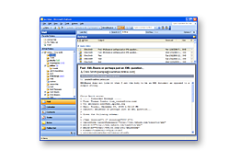
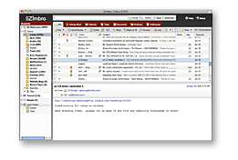









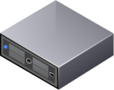



第三部分：终端用户计算——VMware Zimbra定位
以电子邮件客户端为主
局限于Windows平台
本地文件存储
稳定的体验
以 Web 应用程序服务为主
随处访问，跨越平台
私有云和公共云
快速创新，集成式用户界面
最终用户
电子邮件客户端
Web 2.0
专有协作平台
专门的 IT 管理团队
较高的支撑硬件和使用许可成本
有限的集成功能
开放协作平台
兼职管理
云计算，降低总体拥有成本
Web 服务，高度集成
Zimbra
IT 管理
专有服务
开放服务

Slide 37
VMware 虚拟化和云计算管理解决方案
IT 业务管理
终端用户计算
Application Discovery Manager
VMware View
Zimbra
VMware WorkStation
第
四
部
分
Config
Manager
vFabric 家族
Hyperic
云计算应用平台
Sevice
Manager
SpringSource
Cloud Foundry
VMware Operation
CapcityIQ
Site Recovery Manager
Ochestrator
云计算 基础架构和管理
vCD (vCloud Director)
vShield 家族
ChargeBack
vSphere虚拟化基础平台
vCenter
Notes:
Key Points
VMware is the trusted advisor and cloud infrastructure authority
Using this framework we map to specific solution areas that VMware is focused on (walk through the layers and functional areas) and that are important in virtualized and cloud environments.
At first glance some of these areas will be new (vApp Packaging) while others (provisioning, service desk) may seem similar to a traditional view of management, but as you double click in these spaces you will find that we are focused on functionality that is both critical to and takes advantage of managing in a virtualized or cloud environment. In some areas (compliance & security, performance, service desk) we will dramatically redefine how management is done.
VMware Infrastructure and Operations Management solutions enable IT to create a zero-touch, compliant infrastructure. Native management is designed-in to the virtualized and public, private, and hybrid cloud infrastructure to help deliver self-service through policy-driven control.
VMware Application Management solutions enable IT to quickly, accurately, and confidently transition applications to virtualization and the cloud, mapping dependencies, assuring application portability & performance, and establishing service contracts with the infrastructure.
VMware End-User Computing Management allows IT teams to provision & deploy desktops rapidly, manage workstation images simply, and deliver virtualized applications to desktop.
VMware IT Business Management solutions allow IT and service providers to confidently deliver new levels of self-service while ensuring these new services are automatically governed with appropriate business and process-level controls. Self-service without business governance can lead to sprawl, cost, licensing, chargeback, and security issues.

Slide 38
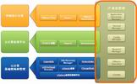
第四部分：IT业务管理
1、vCenter：
大名鼎鼎的vCenter，与vSphere配合使用，同时也是众多其它管理软件的基础，很多管理软件都是通过vCenter实现对于虚拟化平台的专项管理功能。这里不再赘述。
2、VMware Operation：虚拟数据中心运维管理软件。
3、Config Manager(vCM)：配置管理软件。
4、Service Manager(vSM)：遵循ITIL的设备管理软件。
5、Application Discovery Manager(vADM):应用关系管理软件。
以上功能软件，除了vCenter之外，都可以单独部署可以跨越基础架构层与平台层、应用层结合使用，是跨界管理软件。

Slide 39
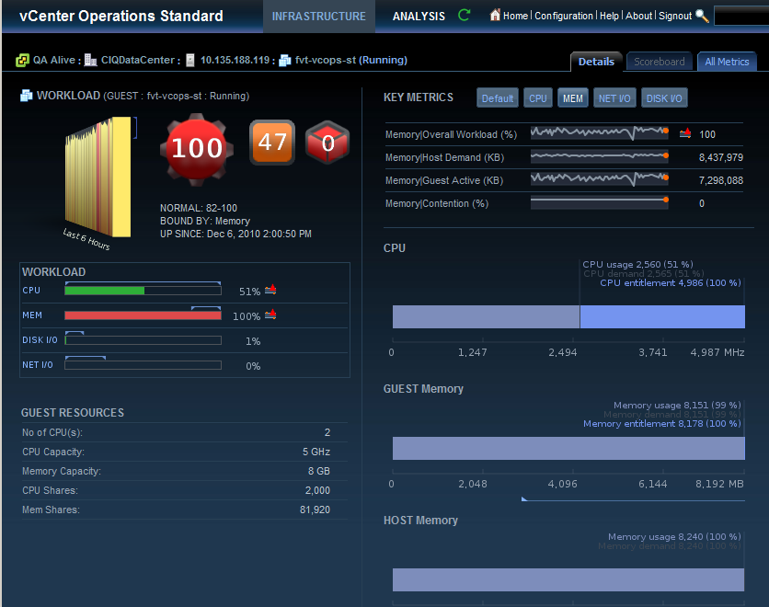

第四部分：IT业务管理——VMware Operations
vCenter Operations –
自动化的操作管理私有云
给我们带来
积极主动提供智能、可视化和自动化，以确保服务水平。
通过
独有专利分析
综合方法的性能、容量和管理配置
Notes:
Key Takeaway: New Product

Slide 40
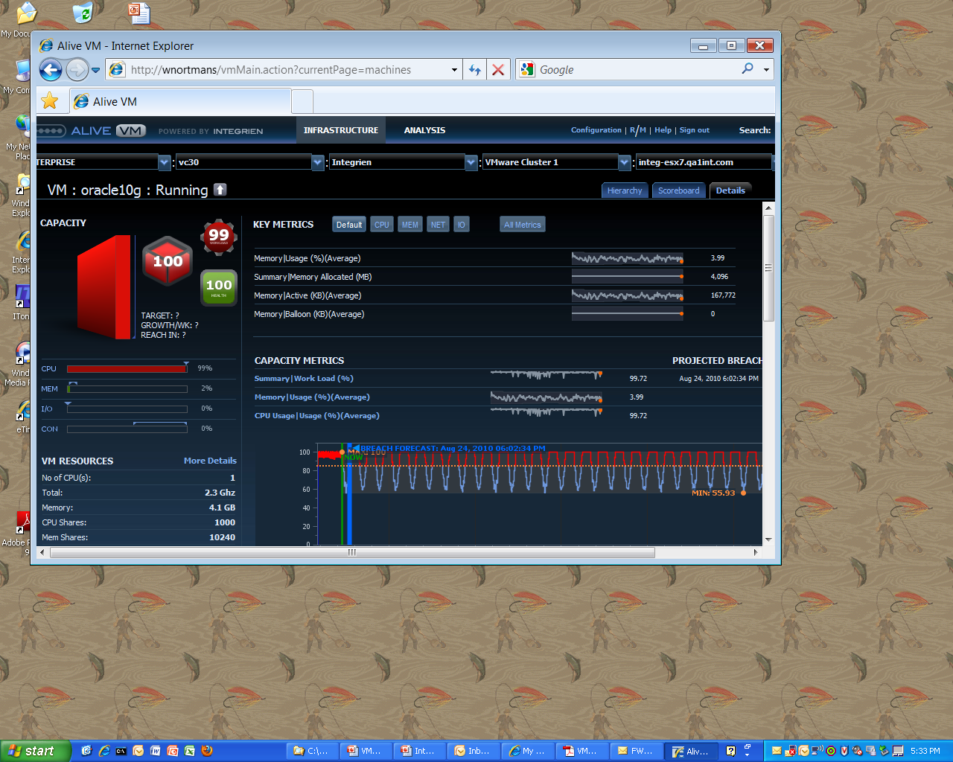
第四部分：IT业务管理——VMware Operations 通过策略可实现从被动管理到主动管理
与 Oracle 负载相关的主动警告
提前数小时 以至数天预测 未来的问题
通过关联负载指标 预测潜在的 违约隐患

Slide 41
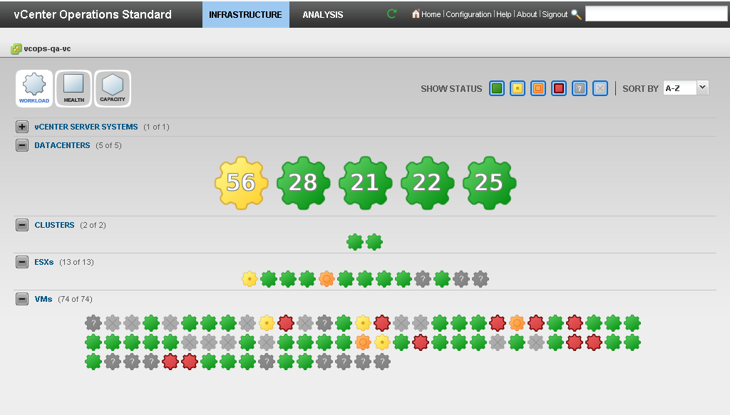
第四部分：IT业务管理——VMware Operations 虚拟数据中心的健康
三个独特的可视化维度
简单、可控的成绩表明整体性能
从“正常“的行为偏差聚焦资源
Notes:
This is all about the three metrics (workload, health and capacity) to differentiate our solution from traditional performance monitoring solutions.

Slide 42
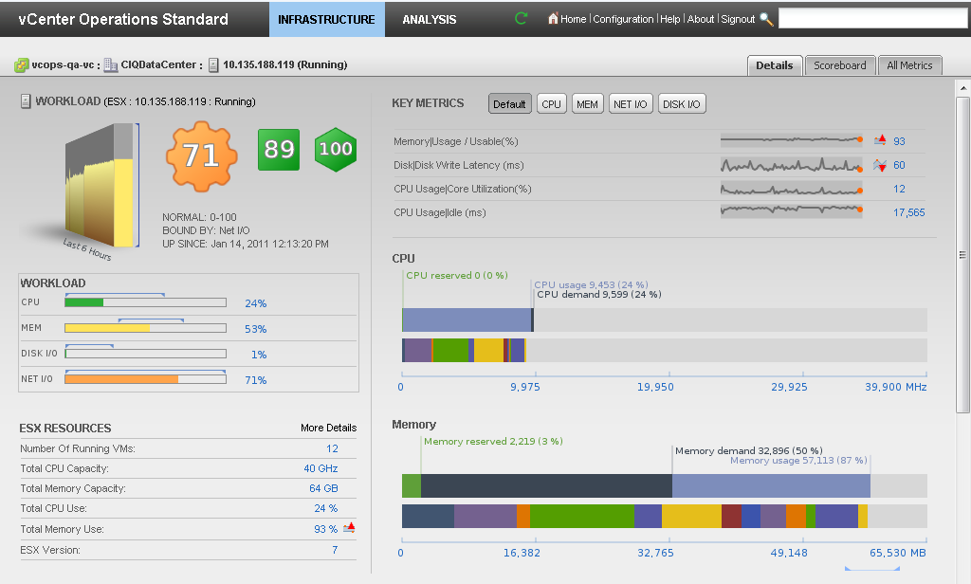
第四部分：IT业务管理——VMware Operations 智能化的深层原因分析
在感兴趣的关键指标的基础上不断的“正常“行为学习
压力是网络 I/O所造成
快速识别问题所在
Notes:
This is about root cause. You can quickly see what is causing the stress.

Slide 43
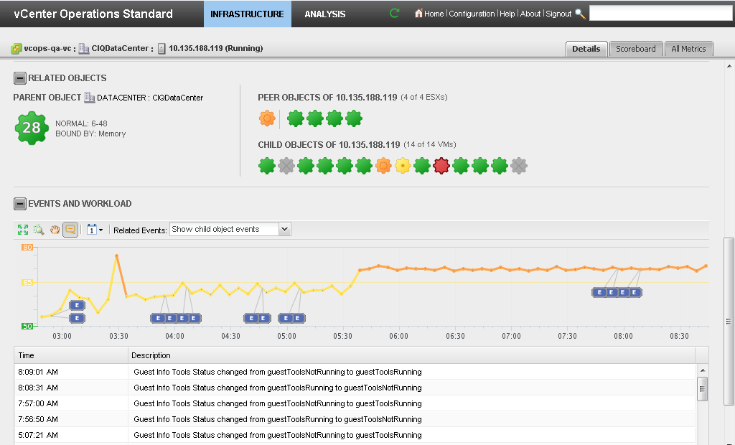
第四部分：IT业务管理——VMware Operations 可视化的性能行为的原因及影响
分层次地对目标进行健康检查
发生在同一时间的相关事件
Notes:
This is about correlating the problem with events (power on/off VM, Vmotion, etc).

Slide 44
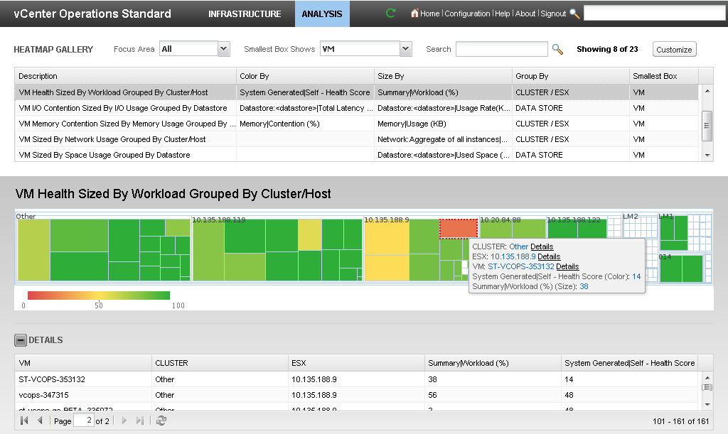
第四部分：IT业务管理——VMware Operations 主动的管理，确保服务水平
可以把VMs 迁移到其它 host吗?
这台host看起来是健康的…
这台host好像过载了 ！
Notes:
This is about remediating problems. You know there is a workload problem and now you want to move a VM from one host to another.

Slide 45
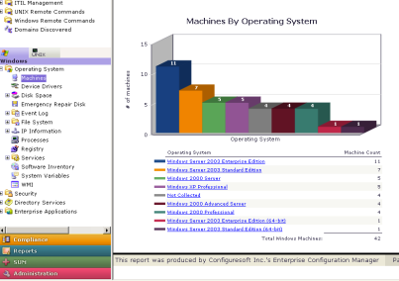
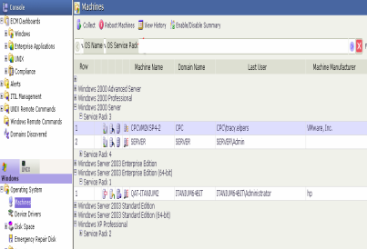
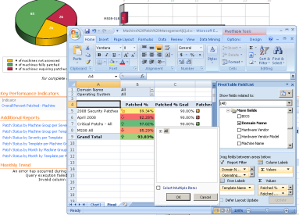
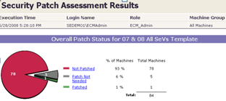
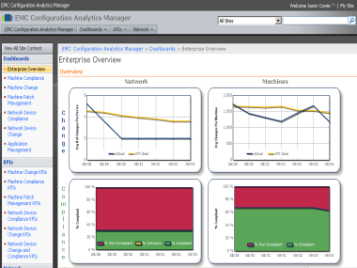
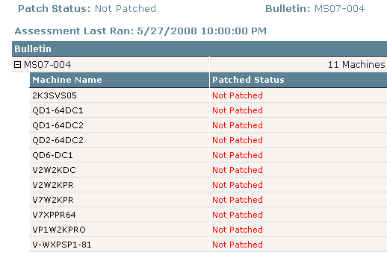
第四部分：IT业务管理——Config Manager能做什么？
TOOL CONSOLIDATION
Server
Workstation
Virtualization
Active Directory
Configuration
Change
Patch
Remediation 修复
Compliance合规
INVENTORY AND BASELINE
（库存和基线）
What do I have?
How is it configured?
What software is running?
Is the software approved or unapproved?
CHANGE MANAGEMENT
（变更管理）
Manage drift
Who, what, where, when, why did something change?
“Right-click fix”
Rollbacks
Planned versus unplanned change
COMPLIANCE & VULNERABILITY
（合规性）
Track who has access to what
Automate password management
Vulnerability/ patch mgmt
Built-in compliance toolkits (PCI, SOX, ISO 2001)
ANALYTICS
（可视化分析）
Dashboard view
Status of the infrastructure
Track KPIs over time
Reports
Notes:
Title
Month Year
45
Okay lets talk about / summarize vCM capabilities, we see that vCM helps with:
<CLICK> Tool consolidation – being able to manage not only physical systems but also AD and (VMware) virtual environments. Know accurate and detailed configuration, change information (including audit trail) but also be able to quickly (automatically) remediate/roll back potential faulty configurations
<CLICK> Inventory and baseline – understand the current inventory and baseline, configuration and where it is originating from
<CLICK> Change management – being able to manage the drift standard builds and audit changes in the environment with the possibility of remediation (right click fix) or roll back of previous changes. Track and understand planned changes opposed to un-planned changes!
vCM also provides the capability to correct mis-configurations where they are found.
Importantly, vCM can not only find problems, but offers a right-click fix capability to more than 80,000 configuration variables.
<CLICK> Compliance and vulnerability - Track permissions and access through the entire IT environment in an enterprise but also make sure there is an automated password, vulnerability and patch management (to relief mundane tasks and be efficient). Due to vCM strong support for (built in OOTB (out of the box)) compliance toolkits (such as PCI, SOX, ISO 2001 but also best practices) it also provides rapid and instant awareness of an enterprise IT compliance and security posture.
<CLICK> Analytics - By tracking configuration changes over time and measuring key performance indicators vCM provide customers a very powerful dashboard for viewing Key Performance Indicators across the server environment. vCM collects, analyzes, and reports on configurations, system changes, and compliance across the physical and virtual server environment.

Slide 46
第四部分：IT业务管理——Service Manager解决的问题(ITSM)
结合ITSM的解决方案
为云时代做好准备
Service Desk（服务台）
Change Management（变更管理）
Request Fulfilment（需求实现）
Asset Management（资产管理）
Cloud Awareness（云意识）
Agility through Configure-and-Go（敏捷管理）
End-to-End Automation（端对端自动化）
Notes:
So you need a solution which can address the needs you have today, but is ready to take you to the Cloud.

Slide 47
第四部分：IT业务管理——Service Manager的流程管理
加强了对基于 vCloud Director 的私有云的治理和控制
1. 审批后进行部署
2. 软件许可证跟踪
3. 基于策略的云分区
向部署请求中添加完善的工作流驱动的审批流程
自动跟踪云中的软件许可证使用情况
简化“组织”的创建过程并通过“蓝图”强制实施标准化
Notes:
Firstly, it adds sophisticated workflow driven approval processes to provisioning requests.
<click>Secondly, it enables you to automatically track the usage of software licenses as vApps as commissioned and decommissioned.
<click> and Thirdly, it simplifies the creation of vCloud Director “Organizations”, and enforces standard settings on those “Organizations” through the use of policies that we call “blueprints”.
Let’s have a look at each of these capabilities in more detail….

Slide 48
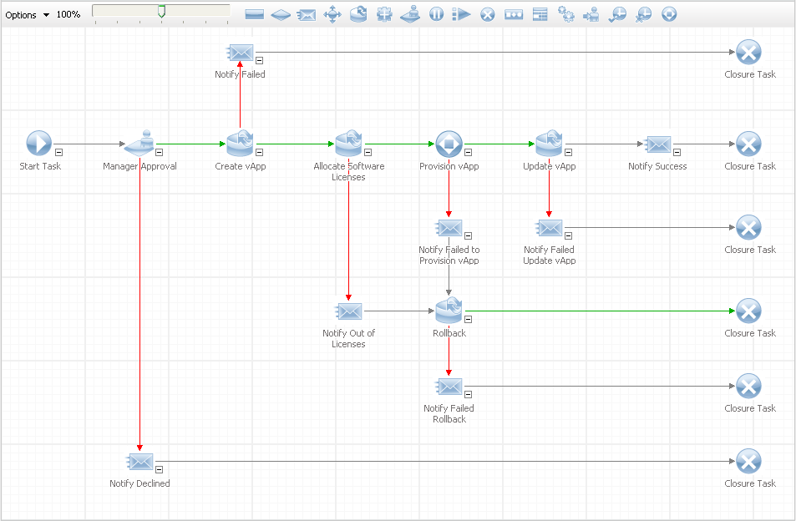
第四部分：IT业务管理——Service Manager中的工作流示例
Notes:
Behind the scenes, the request is governed by a pre-defined workflow. Only a cloud administrator would ever see this workflow view, but its important to understand what is happening.
<click> The first part of the workflow is the approval stage. Here we dynamically look up who the approval needs to go to – in this case the line manager of the requestor. The manager will receive the approval request via email – and they can directly respond to it from their email client. Of course the cloud administrator can change this approval logic if/as needed.
<click> The workflow then allocates any software licenses that have been associated with the template.
<click> The next step is to call out to vCloud Director to perform the actual provisioning. This will instantiate the vApp, deploy it with an appropriate lease, and power it on.
<click> Finally, the workflow sends an email back to the requestor indicating success. This email will have a link in it so the requestor can directly interact with vCloud Director as needed.

Slide 49
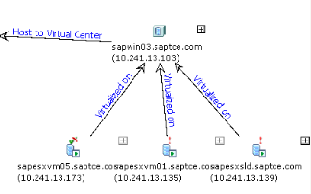
第四部分：IT业务管理——vADM 解决的问题
得到和维护一个快速和准确的数据中心视图
行业的最全面的应用关系依赖关系影射
Dependency Map from vCenter Application Discovery Manager (ADM)
7x More
Accuracy
无代理的、跨越物理及虚拟架构的连续依赖性映射
快速地获得对于服务依赖关系的了解
在不增加风险和复杂性的同时，实现你的虚拟化目标
Example: VMware Blueprinting Services
60%
Faster
10 months
4x Faster
Time
4 months
0
Manual
VMware Services
Notes:
A critical underpinning in building any migration plan, especially one including Tier 1 business critical applications, starts with getting a fast and accurate view.
Many virtualization initiatives slow down as customers struggle to determine which applications (and therefore server groups) should be virtualized next based on business requirements, anticipated ROI and risk. To mitigate risk in migrations, it is imperative to know where the critical applications are running and ALL their infrastructure dependencies so not a single server, network, or storage dependency is unknown and left to chance.
vCenter Application Discovery Manager (ADM) provides the industry’s most comprehensive dependency mapping for virtual and physical environments. It helps customers get a fast and accurate view by uncovering all application dependencies – 7x more than you could with typical manual methods and all without the use of agents..
VMware Service leverage ADM’s automated dependency mapping capabilities to accelerate virtualization and data center initiatives (e.g. migrations) by more than 60%.
The combination of ADM blueprinting and VMware services helps you achieve your virtualization goals on time and reducing risk and complexity.

Slide 50
第四部分：IT业务管理——vADM 概述
不需要代理，被动地发现你的虚拟和物理基础设施
Hosts, application services and dependencies
Relate virtual machine (VM) infrastructure to the different application components
积极收集配置细节
Hardware, OS
Installed software
Leverage Virtual Center
定制发现范围与方法来适应用户需求
分析发现配置项和依赖关系
Virtual and physical dependencies
Application Patterns, Groups, Reports
送达所有虚拟机！
描述和能力
Discovery
Analytics
Virtual-Physical
Dependencies
Application
Dependencies
Virt-Phys Dependencies
Software Dependencies
Host and App Usage
Configuration Details
Application Components
Installed Software
App Infrastructure
(Host, ESX, Guest OS)
Virt & Phys HW/OS
Passive Discovery
Active Discovery
Notes:
Application Discovery Manager - Overview
Application Discovery Manager capabilities can be summarized in four categories:
Passive discovery of your application infrastructure
Active high-definition discovery of hardware and software configuration details
Discovery analytics to visualize, analyze, and report on the collected data
The hybrid discovery methodology of ADM intelligently combines 3 forms of discovery: passive network observations, active remote queries, and discovery analytics to result in discovery that is far less intrusive than competitive solutions. This discovery is completely agentless, so no additional software components need be distributed.
Passive
Application Discovery Manager passive discovery can identify application infrastructure such as servers and application components, and services like application (e.g., Web Logic) and database (e.g., Oracle) servers, host and application usage based on sampled network activity to those hosts, and component dependencies based on these application connections (e.g., MQSeries, SOAP, CitrixICA, JBoss RMI, DB2, SQL).
Active
To complement passive discovery, Application Discovery Manager also utilizes an active discovery capability that collects high-definition details such as CPU, memory, operating system, and processor; installed software on the system (e.g., MySQL server, Tomcat, Web Logic, Samba, Python, Checkpoint VPN, Java 2 SDK); deeper software and hardware configuration details (e.g., installed path, vendor, version, database instances, configuration files and contents, URLs, changes); and software dependencies (e.g., deployed-on, runs-on, virtualized-on relationships).
Analytics
Finally, after the passive and active discovery configuration items are stored in Application Discovery Manager’s database, there are several forms of discovery analytics available to slice and dice the data into views, maps, reports, and groups for custom visualization.
Customize discovery scope
The ability to use profiles that allow you to define and shape the types of active discovery that you are doing.
Timing of active discovery
Level of details to be discovered (shallow, medium, deep, custom)

Slide 51
篇后语
以上为VMware的主要产品线，其它有一些小众化的产品如MVP等等，由于需求暂不明显，尚未纳入其内。
由于重在产品线的突出，因此未对各项技术作深入介绍，只是希望通过此片能够了解这些产品的大致用途，如果感兴趣可以通过查找资料或者联系VMware工程师等方式，获得更多帮助。
IT业界风云变幻，收购整合此起彼伏，VMware也在通过技术研发和整合收购等方式不断完善产品线，因此可能会有部分产品面临名称变更或者产品线的延伸。
总结：
VMware是以虚拟化软件为基础的云计算技术提供厂商，当前最核心的产品主要为“vSphere”、“VMware View”和“vCloud”。其中vCloud涵盖的范围非常广泛和灵活，可以与众多管理软件相结合，以满足不同用户对云计算的需求。

Slide 52
其它产品补充
后续为一些独立的工具、软件以及尚未正式发布的技术和产品。
大致包括：
VMware Converter
Capacity Planner
vCenter Heatbeat
vSphere Storage Appliance
桌面应用产品（ Horizon 、Octopus、Appblast等等）

Slide 53


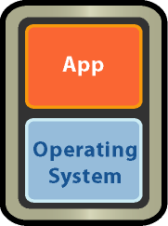

售前容量规划工具——Capacity Planner
VMware Capacity Planner…
是一种业务和决策支持工具
针对专业销售和咨询人员进行了优化
旨在以更快的速度和更高的精确度执行经过基准测试的整合评估
Capacity Planner 提供：
数据中心的完整状态
全面的未来状态整合建议和路线图
最新版本： Capacity Planner 2.8
Notes:
VMware Capacity Planner is…
An award-winning, industry leading IT business and decision support tool
The product is optimized for performing virtual assessments and consolidation estimates/ sizing. Used exclusively by sales and consulting professionals, Capacity Planner is offered as a value-added service to customers by both VMware and partners.
Capacity Planner allows sales and PSO users to perform faster, more accurate and benchmarked consolidation assessments. I will talk more about this in Slide 5 and share with you some statistics that we’ve collected during our assessments.
In effect, CP is a product that allows users to make more informed and relevant decisions by looking at the datacenter holistically. Using CP, users can model different scenario and conduct What-If analysis to derive at the most optimal recommendation.
Leveraging Capacity Planner, you can ensure that your customer’s datacenter achieves strategic, enterprise and transformative success!
Capacity Planner is a consolidation assessment and decision support tool for sales and consulting professionals. In a nutshell, it allows users to do the following:
Data collection: Discover inventory assets and performance metrics of physical infrastructure
Modeling: Define and run multiple scenarios to optimize the datacenter and server utilization
Business planning: Trend and forecast future capacity and resource needs and optimize against Industry Averages
Capacity Planner gives user 2 views into the datacenter:
The As-Is state, what is currently in the datacenter, its relationships and how it’s performing
The To-Be state, what the datacenter can look like in the future with virtualization or a technology refresh/ replacement.

Slide 54



P2V工具——VMware Converter
VMware® Converter 是一个自动将物理主机、其它格式虚拟机和第三方主机映像转化为VMware虚拟机的工具
虚拟机
VMware Converter
物理主机、第三方主机映像和其它格式的虚拟机
最新版本：VMware Converter 5.0（免费使用）

Slide 55
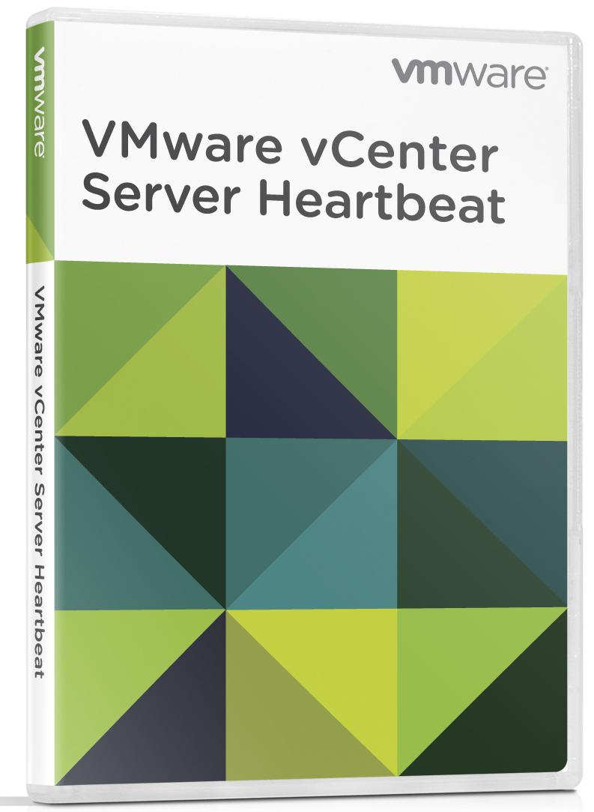
vCenter保护工具——vCenter Heartbeat 6.4
具体含义？
vCenter Server 的高可用性
它有助于防范什么？
以下方面的故障：
硬件、网络、操作系统、应用程序
当 vCenter 不可用时失去了vSphere 的关键特性和功能
按实例销售
产品标价为 9,995 美元
一个许可证可同时保护 vCenter Server 及其数据库（即使数据库安装在其他 主机上）。
Notes:
Impact of vCenter Downtime
KEY = Component - Impact Experienced
Virtual Machines - Management requires direct; can’t provision new VMs from templates
ESXi Servers - Management requires direct connections
Performance & Monitoring Statistics - Historical records will have gaps
vMotion / Storage vMotion - Unavailable
vSphere DRS - Unavailable
vCenter Plug-ins (e.g. VUM) - Unavailable
vSphere HA / FT - HA / FT failover works once, admission control unavailable
VMware VIEW - Cannot provision new desktop instances

Slide 56

vSphere Storage Appliance — 适合所有企业的共享存储
什么是 VSA？
客户获得的好处
VMware vSphere Storage Appliance (VSA)
数分钟即可安装完毕
易于使用
节约资金
1
简单的五次单击
不受服务器故障的 影响
不再需要计划内停机
大幅度降低实施虚拟化门槛
无需共享存储 硬件即可获得 高可用性
2
世界级数据中心 功能 — 即使是 小型环境也可受益
“一次设置，终生 无忧”的自动化
更充分地利用您的 硬件
这款革命性软件能够提供共享存储功能，却不像共享存储那么昂贵和复杂
3

Slide 57







“后PC时代”的VMware相关桌面应用技术（概览）
尚未发布
简化
管理
接入
View
AppBlast
ThinApp
桌面服务
通用服务代理
Horizon Mobile
Horizon Application Manager
Fusion
Workstation
应用编录服务
View Client
Octopus
用户应用数据策略
安全通用访问
数据服务

Slide 58








“后PC时代”的VMware相关桌面应用技术——Horizon: 连接云与移动设备的桥梁
尚未发布
简化
管理
接入
Win
Win
桌面服务
Horizon
SaaS
Mobile
应用编录服务
Entprs
Entprs
基于角色的策略
驱动的数据和应用管理
安全统一的访问
数据服务

Slide 59













“后PC时代”的VMware相关桌面应用技术——Horizon Mobile：引领手机办公的革新
尚未发布
企业办公
虚拟“工作”电话，全加密本地运行；
严格的IT策略控管;
企业应用程序和基础架构支持；
完全隔离;
私人通讯
不受限访问个人应用和数据；
打电话，发微博，玩游戏 ；
私人电话，不受企业IT策略管控；

Slide 60


“后PC时代”的VMware相关桌面应用技术——AppBlast项目：统一应用程序访问
尚未发布
简化
管理
接入
HTML 5.0
桌面服务
通用服
务代理
SaaS
Entprs
Win
Win
Mobile
Entprs
HTML 5.0
应用编录服务
基于角色的策略驱
动的数据和应用管理
安全
统一的访问
Data Service
任意平台上通过浏览器访问Windows，Linux应用程序，无需安装任何客户端

Slide 61
其它产品
尚未确定
vCenter Protect Essentials Plus:
Data Preparation Assistant (DPA):
https://www.gosavo.com/vmware/Post/Post.aspx?id=6472020&view=

Slide 62
计费方式汇总
VMware产品线有4种计费方式：
1、vSphere——按照CPU计费，与core无关。
2、VMware View——按照“并发用户数”计费。
3、vFabric——按照组件“个数”计费，需要几个组件，就买几个vFabric，组件之间自由组合，搭建合适的PASS平台。
4、其它产品——皆按照虚拟机（VM）个数计费，大部分以“25个VM”为基本计费单位购买。

Slide 63



举例——典型“云计算”技术框架（引自合作伙伴）
服务层
软件即服务SaaS
平台即服务PaaS
数据存储即服务DaaS
基础设施即服务IaaS
示例
云运营中心
云基础架构平台
云安全中心
服务目录管理
云中间件
企业数据总线
应用服务器
关系数据库
NoSQL DB
分布式计算
身份安全
服务水平管理
计算管理
网络安全
服务流程管理
云操作系统
存储管理
网络管理
系统管理
用户管理
服务管理
统一资源池
数据安全
逻辑资源池
(计算资源、存储资源、网络资源)
客户项目管理
资源池化
内容安全
生命周期管理
计费账单管理
云优化硬件
…
安全管理
业务管理
数据中心基础设施
CloudBase
模块化数据中心
CloudBase
集装箱数据中心

Slide 64


Thank You

